Slide 1
Arrays
BACS2023 Object-Oriented Programming
Appendix A5

Slide 2
Motivations
Often you will have to store a large number of values during the execution of a program. Suppose, for instance, that you need to read one hundred numbers, compute their average, and find out how many numbers are above the average. Your program first reads the numbers and computes their average, and then compares each number with the average to determine whether it is above the average. The numbers must all be stored in variables in order to accomplish this task. You have to declare one hundred variables and repeatedly write almost identical code one hundred times. From the standpoint of practicality, it is impossible to write a program this way. So, how do you solve this problem?

Slide 3
Learning Objectives
At the end of this chapter, you should be able to
Explain why arrays are necessary in programming.
Describe the steps involved in using arrays: declaring array reference variables and creating arrays.
Initialize the values in an array.
Access array elements using indexed variables.
Declare, create, and initialize an array using an array initializer.
Copy contents from one array to another.
Develop and invoke methods with array arguments and return value.
Declare a method with variable-length argument list (§6.6).
Use the methods in the Arrays class (§6.9).
To declare and create two-dimensional and multidimensional arrays to solve programming problems.

Slide 4
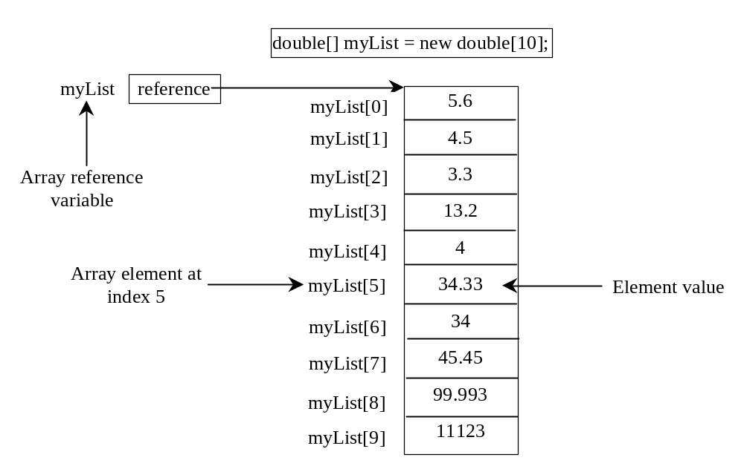
Introducing Arrays
Array is a data structure that represents a collection of the same types of data.

Slide 5
Declaring Array Variables
datatype[] arrayRefVar;
Example:
double[] myList;
datatype arrayRefVar[]; // This style is allowed, but not preferred
Example:
double myList[];

Slide 6
Creating Arrays
arrayRefVar = new datatype[arraySize];
Example:
myList = new double[10];
myList[0] references the first element in the array.
myList[9] references the last element in the array.

Slide 7
Declaring and Creating in One Step
datatype[] arrayRefVar = new
datatype[arraySize];
double[] myList = new double[10];
datatype arrayRefVar[] = new
datatype[arraySize];
double myList[] = new double[10];

Slide 8
The Length of an Array
Once an array is created, its size is fixed. It cannot be changed. You can find its size using
    arrayRefVar.length
For example,
    myList.length returns 10

Slide 9
Default Values
When an array is created, its elements are assigned the default value of
  0 for the numeric primitive data types,
  '\u0000' for char types, and
  false for boolean types.

Slide 10
Indexed Variables
The array elements are accessed through the index. The array indices are 0-based, i.e., it starts from 0 to arrayRefVar.length-1. In the example in Figure 6.1, myList holds ten double values and the indices are from 0 to 9.
Each element in the array is represented using the following syntax, known as an indexed variable:
  arrayRefVar[index];

Slide 11
Using Indexed Variables
After an array is created, an indexed variable can be used in the same way as a regular variable. For example, the following code adds the value in myList[0] and myList[1] to myList[2].
  myList[2] = myList[0] + myList[1];

Slide 12
Array Initializers
Declaring, creating, initializing in one step:
double[] myList = {1.9, 2.9, 3.4, 3.5};
This shorthand syntax must be in one statement.

Slide 13
Declaring, creating, initializing Using the Shorthand Notation
double[] myList = {1.9, 2.9, 3.4, 3.5};
This shorthand notation is equivalent to the following statements:
double[] myList = new double[4];
myList[0] = 1.9;
myList[1] = 2.9;
myList[2] = 3.4;
myList[3] = 3.5;

Slide 14
CAUTION
Using the shorthand notation, you have to declare, create, and initialize the array all in one statement. Splitting it would cause a syntax error. For example, the following is wrong:
  double[] myList;
  myList = {1.9, 2.9, 3.4, 3.5};

Slide 15
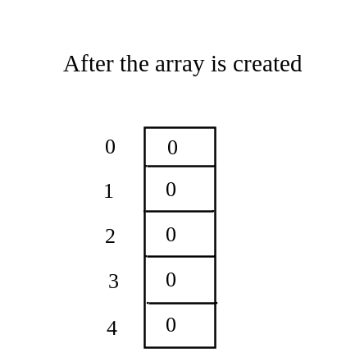
Trace Program with Arrays
animation
Declare array variable values, create an array, and assign its reference to values
public class Test {
public static void main(String[] args) {
int[] values = new int[5];
for (int i = 1; i < 5; i++) {
values[i] = values[i] + values[i-1];
}
values[0] = values[1] + values[4];
}
}

Slide 16
Trace Program with Arrays
animation
i becomes 1
public class Test {
public static void main(String[] args) {
int[] values = new int[5];
for (int i = 1; i < 5; i++) {
values[i] = values[i] + values[i-1];
}
values[0] = values[1] + values[4];
}
}

Slide 17
Trace Program with Arrays
animation
i (=1) is less than 5
public class Test {
public static void main(String[] args) {
int[] values = new int[5];
for (int i = 1; i < 5; i++) {
values[i] = values[i] + values[i-1];
}
values[0] = values[1] + values[4];
}
}

Slide 18
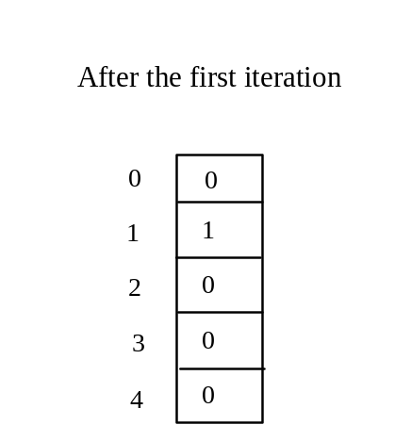
Trace Program with Arrays
animation
After this line is executed, value[1] is 1
public class Test {
public static void main(String[] args) {
int[] values = new int[5];
for (int i = 1; i < 5; i++) {
values[i] = i + values[i-1];
}
values[0] = values[1] + values[4];
}
}

Slide 19
Trace Program with Arrays
animation
After i++, i becomes 2
public class Test {
public static void main(String[] args) {
int[] values = new int[5];
for (int i = 1; i < 5; i++) {
values[i] = values[i] + values[i-1];
}
values[0] = values[1] + values[4];
}
}

Slide 20
Trace Program with Arrays
animation
i (= 2) is less than 5
public class Test {
public static void main(String[] args) {
int[] values = new int[5];
for (int i = 1; i < 5; i++) {
values[i] = values[i] + values[i-1];
}
values[0] = values[1] + values[4];
}
}

Slide 21
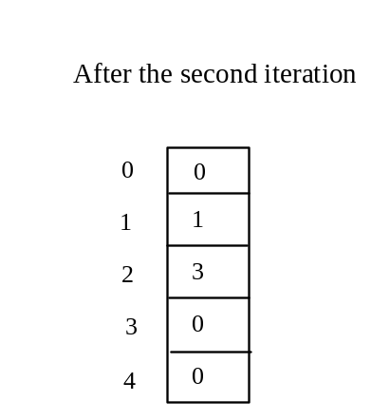
Trace Program with Arrays
animation
After this line is executed,
values[2] is 3 (2 + 1)
public class Test {
public static void main(String[] args) {
int[] values = new int[5];
for (int i = 1; i < 5; i++) {
values[i] = i + values[i-1];
}
values[0] = values[1] + values[4];
}
}

Slide 22
Trace Program with Arrays
animation
After this, i becomes 3.
public class Test {
public static void main(String[] args) {
int[] values = new int[5];
for (int i = 1; i < 5; i++) {
values[i] = i + values[i-1];
}
values[0] = values[1] + values[4];
}
}

Slide 23
Trace Program with Arrays
animation
i (=3) is still less than 5.
public class Test {
public static void main(String[] args) {
int[] values = new int[5];
for (int i = 1; i < 5; i++) {
values[i] = i + values[i-1];
}
values[0] = values[1] + values[4];
}
}

Slide 24
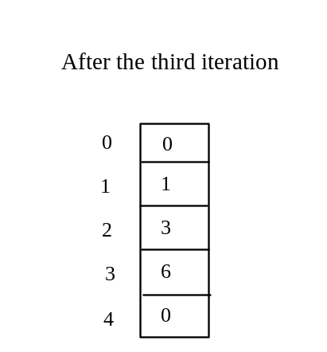
Trace Program with Arrays
animation
After this line, values[3] becomes 6 (3 + 3)
public class Test {
public static void main(String[] args) {
int[] values = new int[5];
for (int i = 1; i < 5; i++) {
values[i] = i + values[i-1];
}
values[0] = values[1] + values[4];
}
}

Slide 25

Trace Program with Arrays
animation
After this, i becomes 4
public class Test {
public static void main(String[] args) {
int[] values = new int[5];
for (int i = 1; i < 5; i++) {
values[i] = i + values[i-1];
}
values[0] = values[1] + values[4];
}
}

Slide 26
Trace Program with Arrays
animation
i (=4) is still less than 5
public class Test {
public static void main(String[] args) {
int[] values = new int[5];
for (int i = 1; i < 5; i++) {
values[i] = i + values[i-1];
}
values[0] = values[1] + values[4];
}
}

Slide 27
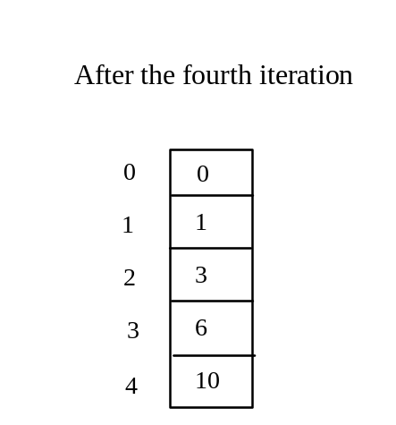
Trace Program with Arrays
animation
After this, values[4] becomes 10 (4 + 6)
public class Test {
public static void main(String[] args) {
int[] values = new int[5];
for (int i = 1; i < 5; i++) {
values[i] = i + values[i-1];
}
values[0] = values[1] + values[4];
}
}

Slide 28
Trace Program with Arrays
animation
After i++, i becomes 5
public class Test {
public static void main(String[] args) {
int[] values = new int[5];
for (int i = 1; i < 5; i++) {
values[i] = i + values[i-1];
}
values[0] = values[1] + values[4];
}
}

Slide 29
Trace Program with Arrays
animation
i ( =5) < 5 is false. Exit the loop
public class Test {
public static void main(String[] args) {
int[] values = new int[5];
for (int i = 1; i < 5; i++) {
values[i] = i + values[i-1];
}
values[0] = values[1] + values[4];
}
}

Slide 30
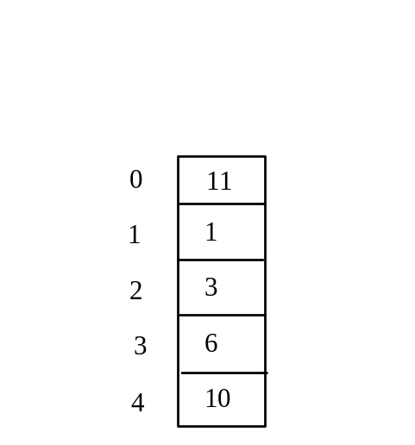
Trace Program with Arrays
animation
After this line, values[0] is 11 (1 + 10)
public class Test {
public static void main(String[] args) {
int[] values = new int[5];
for (int i = 1; i < 5; i++) {
values[i] = i + values[i-1];
}
values[0] = values[1] + values[4];
}
}

Slide 31
Processing Arrays
See the examples in the text.
(Initializing arrays)
(Printing arrays)
(Summing all elements)
(Finding the largest element)
(Finding the smallest index of the largest element)
(Random shuffling)
(Shifting elements)

Slide 32
Enhanced for Loop (for-each loop)
JDK 1.5 introduced a new for loop that enables you to traverse the complete array sequentially without using an index variable. For example, the following code displays all elements in the array myList:
  for (double value: myList)
  System.out.println(value);
In general, the syntax is
  for (elementType value: arrayRefVar) {
  // Process the value
  }
You still have to use an index variable if you wish to traverse the array in a different order or change the elements in the array.

Slide 33
Example: Analyzing Array Elements
Objective: The program receives 6 numbers from the user, finds the largest number and counts the occurrence of the largest number entered.
Suppose you entered 3, 5, 2, 5, 5, and 5, the largest number is 5 and its occurrence count is 4.
TestArray
Run

Slide 34
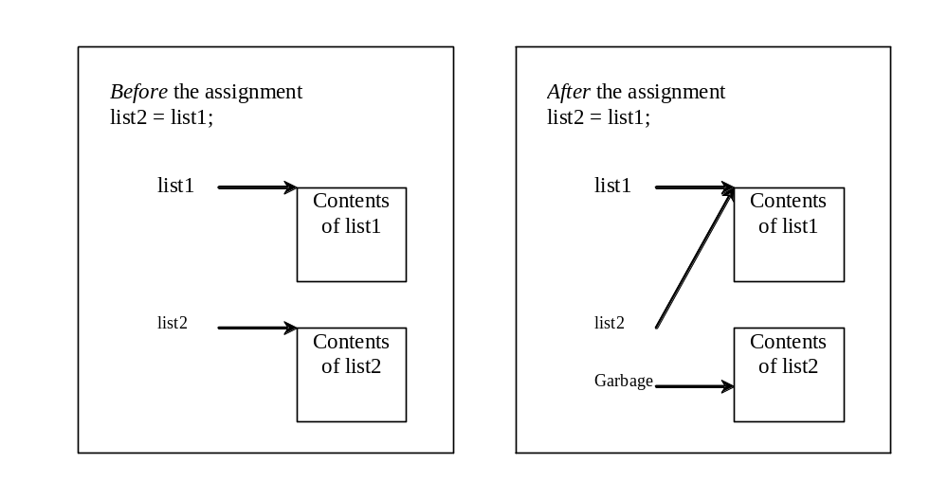
Copying Arrays
Often, in a program, you need to duplicate an array or a part of an array. In such cases you could attempt to use the assignment statement (=), as follows:
list2 = list1;

Slide 35
Copying Arrays
Using a loop:
int[] sourceArray = {2, 3, 1, 5, 10};
int[] targetArray = new int[sourceArray.length];
for (int i = 0; i < sourceArrays.length; i++)
targetArray[i] = sourceArray[i];

Slide 36
The arraycopy Utility
arraycopy(sourceArray, src_pos, targetArray, tar_pos, length);
Example:
System.arraycopy(sourceArray, 0, targetArray, 0, sourceArray.length);

Slide 37
Passing Arrays to Methods
public static void printArray(int[] array) {
for (int i = 0; i < array.length; i++) {
System.out.print(array[i] + " ");
}
}
Invoke the method
int[] list = {3, 1, 2, 6, 4, 2};
printArray(list);
Invoke the method
printArray(new int[]{3, 1, 2, 6, 4, 2});
Anonymous array

Slide 38
Anonymous Array
  The statement
    printArray(new int[]{3, 1, 2, 6, 4, 2});
  creates an array using the following syntax:
    new dataType[]{literal0, literal1, ..., literalk};
  There is no explicit reference variable for the array. Such array is called an anonymous array.

Slide 39
Pass By Value
Java uses pass by value to pass arguments to a method. There are important differences between passing a value of variables of primitive data types and passing arrays.
For a parameter of a primitive type value, the actual value is passed. Changing the value of the local parameter inside the method does not affect the value of the variable outside the method.
For a parameter of an array type, the value of the parameter contains a reference to an array; this reference is passed to the method. Any changes to the array that occur inside the method body will affect the original array that was passed as the argument.

Slide 40
Simple Example
public class Test {
public static void main(String[] args) {
int x = 1; // x represents an int value
int[] y = new int[10]; // y represents an array of int values
m(x, y); // Invoke m with arguments x and y
System.out.println("x is " + x);
System.out.println("y[0] is " + y[0]);
}
public static void m(int number, int[] numbers) {
number = 1001; // Assign a new value to number
numbers[0] = 5555; // Assign a new value to numbers[0]
}
}

Slide 41
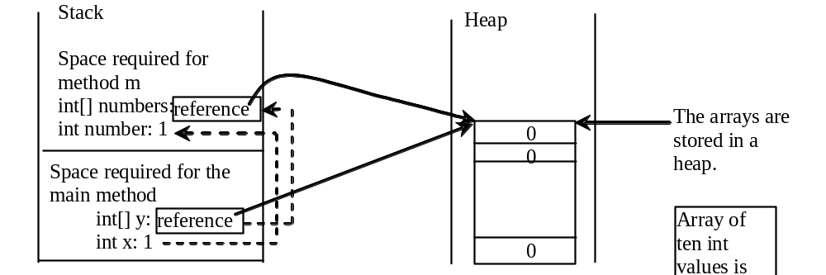
Call Stack
When invoking m(x, y), the values of x and y are passed to number and numbers. Since y contains the reference value to the array, numbers now contains the same reference value to the same array.

Slide 42
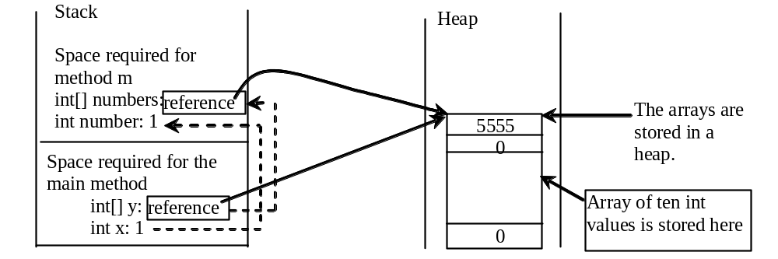
Call Stack
When invoking m(x, y), the values of x and y are passed to number and numbers. Since y contains the reference value to the array, numbers now contains the same reference value to the same array.

Slide 43
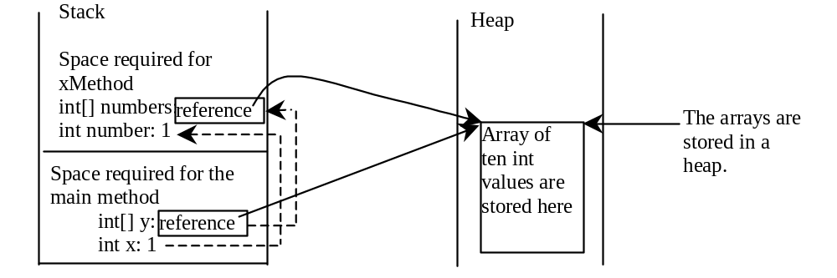
Heap
The JVM stores the array in an area of memory, called heap, which is used for dynamic memory allocation where blocks of memory are allocated and freed in an arbitrary order.

Slide 44
Passing Arrays as Arguments
Objective: Demonstrate differences of passing primitive data type variables and array variables.
TestPassArray
Run

Slide 45
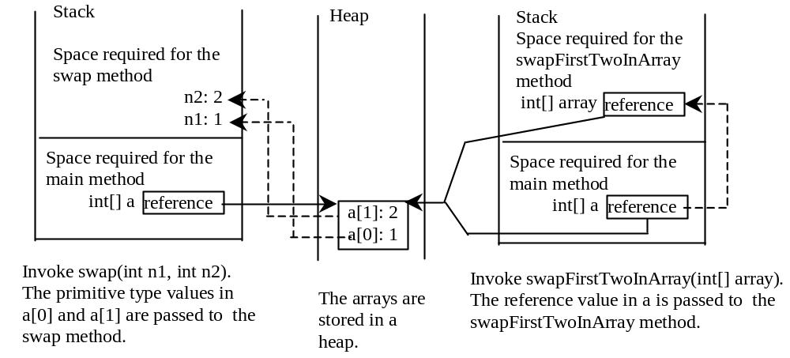
Example, cont.

Slide 46
Returning an Array from a Method
public static int[] reverse(int[] list) {
int[] result = new int[list.length];
for (int i = 0, j = result.length - 1;
i < list.length; i++, j--) {
result[j] = list[i];
}
return result;
}
list
result
int[] list1 = new int[]{1, 2, 3, 4, 5, 6};
int[] list2 = reverse(list1);

Slide 47
Trace the reverse Method
animation
int[] list1 = new int[]{1, 2, 3, 4, 5, 6};
int[] list2 = reverse(list1);
Declare result and create array
public static int[] reverse(int[] list) {
int[] result = new int[list.length];
for (int i = 0, j = result.length - 1;
i < list.length; i++, j--) {
result[j] = list[i];
}
return result;
}
list
1
2
3
4
5
6
result
0
0
0
0
0
0

Slide 48
Trace the reverse Method, cont.
animation
int[] list1 = new int[]{1, 2, 3, 4, 5, 6};
int[] list2 = reverse(list1);
i = 0 and j = 5
public static int[] reverse(int[] list) {
int[] result = new int[list.length];
for (int i = 0, j = result.length - 1;
i < list.length; i++, j--) {
result[j] = list[i];
}
return result;
}
list
1
2
3
4
5
6
result
0
0
0
0
0
0

Slide 49
Trace the reverse Method, cont.
animation
int[] list1 = new int[]{1, 2, 3, 4, 5, 6};
int[] list2 = reverse(list1);
i (= 0) is less than 6
public static int[] reverse(int[] list) {
int[] result = new int[list.length];
for (int i = 0, j = result.length - 1;
i < list.length; i++, j--) {
result[j] = list[i];
}
return result;
}
list
1
2
3
4
5
6
result
0
0
0
0
0
0

Slide 50
Trace the reverse Method, cont.
animation
int[] list1 = new int[]{1, 2, 3, 4, 5, 6};
int[] list2 = reverse(list1);
i = 0 and j = 5
Assign list[0] to result[5]
public static int[] reverse(int[] list) {
int[] result = new int[list.length];
for (int i = 0, j = result.length - 1;
i < list.length; i++, j--) {
result[j] = list[i];
}
return result;
}
list
1
2
3
4
5
6
result
0
0
0
0
0
1

Slide 51
Trace the reverse Method, cont.
animation
int[] list1 = new int[]{1, 2, 3, 4, 5, 6};
int[] list2 = reverse(list1);
After this, i becomes 1 and j becomes 4
public static int[] reverse(int[] list) {
int[] result = new int[list.length];
for (int i = 0, j = result.length - 1;
i < list.length; i++, j--) {
result[j] = list[i];
}
return result;
}
list
1
2
3
4
5
6
result
0
0
0
0
0
1

Slide 52
Trace the reverse Method, cont.
animation
int[] list1 = new int[]{1, 2, 3, 4, 5, 6};
int[] list2 = reverse(list1);
i (=1) is less than 6
public static int[] reverse(int[] list) {
int[] result = new int[list.length];
for (int i = 0, j = result.length - 1;
i < list.length; i++, j--) {
result[j] = list[i];
}
return result;
}
list
1
2
3
4
5
6
result
0
0
0
0
0
1

Slide 53
Trace the reverse Method, cont.
animation
int[] list1 = new int[]{1, 2, 3, 4, 5, 6};
int[] list2 = reverse(list1);
i = 1 and j = 4
Assign list[1] to result[4]
public static int[] reverse(int[] list) {
int[] result = new int[list.length];
for (int i = 0, j = result.length - 1;
i < list.length; i++, j--) {
result[j] = list[i];
}
return result;
}
list
1
2
3
4
5
6
result
0
0
0
0
2
1

Slide 54
Trace the reverse Method, cont.
animation
int[] list1 = new int[]{1, 2, 3, 4, 5, 6};
int[] list2 = reverse(list1);
After this, i becomes 2 and j becomes 3
public static int[] reverse(int[] list) {
int[] result = new int[list.length];
for (int i = 0, j = result.length - 1;
i < list.length; i++, j--) {
result[j] = list[i];
}
return result;
}
list
1
2
3
4
5
6
result
0
0
0
0
2
1

Slide 55
Trace the reverse Method, cont.
animation
int[] list1 = new int[]{1, 2, 3, 4, 5, 6};
int[] list2 = reverse(list1);
i (=2) is still less than 6
public static int[] reverse(int[] list) {
int[] result = new int[list.length];
for (int i = 0, j = result.length - 1;
i < list.length; i++, j--) {
result[j] = list[i];
}
return result;
}
list
1
2
3
4
5
6
result
0
0
0
0
2
1

Slide 56
Trace the reverse Method, cont.
animation
int[] list1 = new int[]{1, 2, 3, 4, 5, 6};
int[] list2 = reverse(list1);
i = 2 and j = 3
Assign list[i] to result[j]
public static int[] reverse(int[] list) {
int[] result = new int[list.length];
for (int i = 0, j = result.length - 1;
i < list.length; i++, j--) {
result[j] = list[i];
}
return result;
}
list
1
2
3
4
5
6
result
0
0
0
3
2
1

Slide 57
Trace the reverse Method, cont.
animation
int[] list1 = new int[]{1, 2, 3, 4, 5, 6};
int[] list2 = reverse(list1);
After this, i becomes 3 and j becomes 2
public static int[] reverse(int[] list) {
int[] result = new int[list.length];
for (int i = 0, j = result.length - 1;
i < list.length; i++, j--) {
result[j] = list[i];
}
return result;
}
list
1
2
3
4
5
6
result
0
0
0
3
2
1

Slide 58
Trace the reverse Method, cont.
animation
int[] list1 = new int[]{1, 2, 3, 4, 5, 6};
int[] list2 = reverse(list1);
i (=3) is still less than 6
public static int[] reverse(int[] list) {
int[] result = new int[list.length];
for (int i = 0, j = result.length - 1;
i < list.length; i++, j--) {
result[j] = list[i];
}
return result;
}
list
1
2
3
4
5
6
result
0
0
0
3
2
1

Slide 59
Trace the reverse Method, cont.
animation
int[] list1 = new int[]{1, 2, 3, 4, 5, 6};
int[] list2 = reverse(list1);
i = 3 and j = 2
Assign list[i] to result[j]
public static int[] reverse(int[] list) {
int[] result = new int[list.length];
for (int i = 0, j = result.length - 1;
i < list.length; i++, j--) {
result[j] = list[i];
}
return result;
}
list
1
2
3
4
5
6
result
0
0
4
3
2
1

Slide 60
Trace the reverse Method, cont.
animation
int[] list1 = new int[]{1, 2, 3, 4, 5, 6};
int[] list2 = reverse(list1);
After this, i becomes 4 and j becomes 1
public static int[] reverse(int[] list) {
int[] result = new int[list.length];
for (int i = 0, j = result.length - 1;
i < list.length; i++, j--) {
result[j] = list[i];
}
return result;
}
list
1
2
3
4
5
6
result
0
0
4
3
2
1

Slide 61
Trace the reverse Method, cont.
animation
int[] list1 = new int[]{1, 2, 3, 4, 5, 6};
int[] list2 = reverse(list1);
i (=4) is still less than 6
public static int[] reverse(int[] list) {
int[] result = new int[list.length];
for (int i = 0, j = result.length - 1;
i < list.length; i++, j--) {
result[j] = list[i];
}
return result;
}
list
1
2
3
4
5
6
result
0
0
4
3
2
1

Slide 62
Trace the reverse Method, cont.
animation
int[] list1 = new int[]{1, 2, 3, 4, 5, 6};
int[] list2 = reverse(list1);
i = 4 and j = 1
Assign list[i] to result[j]
public static int[] reverse(int[] list) {
int[] result = new int[list.length];
for (int i = 0, j = result.length - 1;
i < list.length; i++, j--) {
result[j] = list[i];
}
return result;
}
list
1
2
3
4
5
6
result
0
5
4
3
2
1

Slide 63
Trace the reverse Method, cont.
animation
int[] list1 = new int[]{1, 2, 3, 4, 5, 6};
int[] list2 = reverse(list1);
After this, i becomes 5 and j becomes 0
public static int[] reverse(int[] list) {
int[] result = new int[list.length];
for (int i = 0, j = result.length - 1;
i < list.length; i++, j--) {
result[j] = list[i];
}
return result;
}
list
1
2
3
4
5
6
result
0
5
4
3
2
1

Slide 64
Trace the reverse Method, cont.
animation
int[] list1 = new int[]{1, 2, 3, 4, 5, 6};
int[] list2 = reverse(list1);
i (=5) is still less than 6
public static int[] reverse(int[] list) {
int[] result = new int[list.length];
for (int i = 0, j = result.length - 1;
i < list.length; i++, j--) {
result[j] = list[i];
}
return result;
}
list
1
2
3
4
5
6
result
0
5
4
3
2
1

Slide 65
Trace the reverse Method, cont.
animation
int[] list1 = new int[]{1, 2, 3, 4, 5, 6};
int[] list2 = reverse(list1);
i = 5 and j = 0
Assign list[i] to result[j]
public static int[] reverse(int[] list) {
int[] result = new int[list.length];
for (int i = 0, j = result.length - 1;
i < list.length; i++, j--) {
result[j] = list[i];
}
return result;
}
list
1
2
3
4
5
6
result
6
5
4
3
2
1

Slide 66
Trace the reverse Method, cont.
animation
int[] list1 = new int[]{1, 2, 3, 4, 5, 6};
int[] list2 = reverse(list1);
After this, i becomes 6 and j becomes -1
public static int[] reverse(int[] list) {
int[] result = new int[list.length];
for (int i = 0, j = result.length - 1;
i < list.length; i++, j--) {
result[j] = list[i];
}
return result;
}
list
1
2
3
4
5
6
result
6
5
4
3
2
1

Slide 67
Trace the reverse Method, cont.
animation
int[] list1 = new int[]{1, 2, 3, 4, 5, 6};
int[] list2 = reverse(list1);
i (=6) < 6 is false. So exit the loop.
public static int[] reverse(int[] list) {
int[] result = new int[list.length];
for (int i = 0, j = result.length - 1;
i < list.length; i++, j--) {
result[j] = list[i];
}
return result;
}
list
1
2
3
4
5
6
result
6
5
4
3
2
1

Slide 68
Trace the reverse Method, cont.
animation
int[] list1 = new int[]{1, 2, 3, 4, 5, 6};
int[] list2 = reverse(list1);
Return result
public static int[] reverse(int[] list) {
int[] result = new int[list.length];
for (int i = 0, j = result.length - 1;
i < list.length; i++, j--) {
result[j] = list[i];
}
return result;
}
list
1
2
3
4
5
6
list2
result
6
5
4
3
2
1

Slide 69
The Arrays.binarySearch Method
Since binary search is frequently used in programming, Java provides several overloaded binarySearch methods for searching a key in an array of int, double, char, short, long, and float in the java.util.Arrays class. For example, the following code searches the keys in an array of numbers and an array of characters.
  int[] list = {2, 4, 7, 10, 11, 45, 50, 59, 60, 66, 69, 70, 79};
  System.out.println("Index is " +
  java.util.Arrays.binarySearch(list, 11));
  char[] chars = {'a', 'c', 'g', 'x', 'y', 'z'};
  System.out.println("Index is " +
  java.util.Arrays.binarySearch(chars, 't'));
For the binarySearch method to work, the array must be pre-sorted in increasing order.
Return is 4
Return is –4 (insertion point is 3, so return is -3-1)

Slide 70
The Arrays.sort Method
Since sorting is frequently used in programming, Java provides several overloaded sort methods for sorting an array of int, double, char, short, long, and float in the java.util.Arrays class. For example, the following code sorts an array of numbers and an array of characters.
  double[] numbers = {6.0, 4.4, 1.9, 2.9, 3.4, 3.5};
  java.util.Arrays.sort(numbers);
  char[] chars = {'a', 'A', '4', 'F', 'D', 'P'};
  java.util.Arrays.sort(chars);

Slide 71
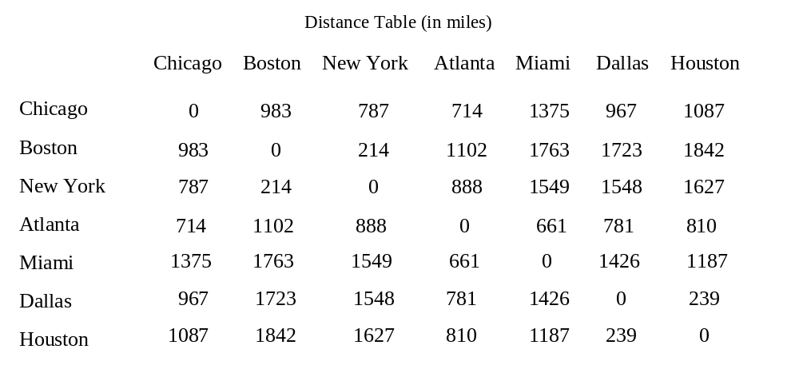
Two-dimensional Arrays
Thus far, you have used one-dimensional arrays to model linear collections of elements. You can use a two-dimensional array to represent a matrix or a table. For example, the following table that describes the distances between the cities can be represented using a two-dimensional array.

Slide 72
Declare/Create Two-dimensional Arrays
// Declare array ref var
dataType[][] refVar;
// Create array and assign its reference to variable
refVar = new dataType[10][10];
// Combine declaration and creation in one statement
dataType[][] refVar = new dataType[10][10];
// Alternative syntax
dataType refVar[][] = new dataType[10][10];

Slide 73
Declaring Variables of Two-dimensional Arrays and Creating Two-dimensional Arrays
int[][] matrix = new int[10][10];
or
int matrix[][] = new int[10][10];
matrix[0][0] = 3;
for (int i = 0; i < matrix.length; i++)
for (int j = 0; j < matrix[i].length; j++)
matrix[i][j] = (int)(Math.random() * 1000);
double[][] x;

Slide 74
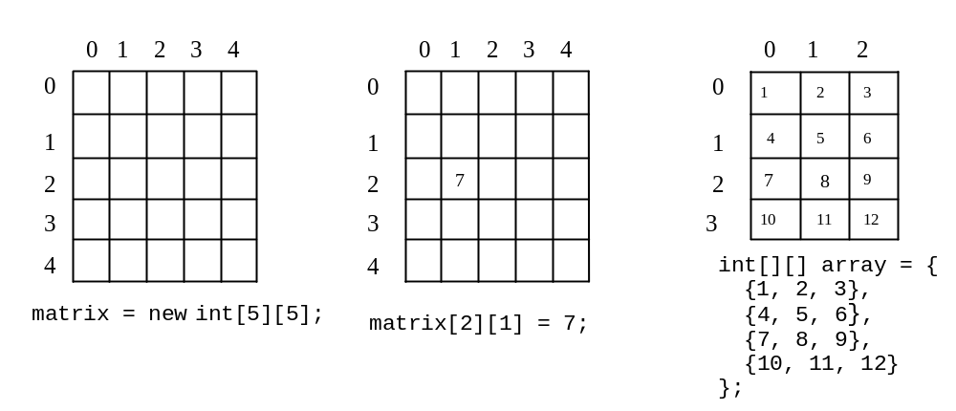
Two-dimensional Array Illustration
matrix.length? 5
matrix[0].length? 5
array.length? 4
array[0].length? 3

Slide 75
Declaring, Creating, and Initializing Using Shorthand Notations
You can also use an array initializer to declare, create and initialize a two-dimensional array. For example,
int[][] array = {
{1, 2, 3},
{4, 5, 6},
{7, 8, 9},
{10, 11, 12}
};
int[][] array = new int[4][3];
array[0][0] = 1; array[0][1] = 2; array[0][2] = 3;
array[1][0] = 4; array[1][1] = 5; array[1][2] = 6;
array[2][0] = 7; array[2][1] = 8; array[2][2] = 9;
array[3][0] = 10; array[3][1] = 11; array[3][2] = 12;
Same as

Slide 76
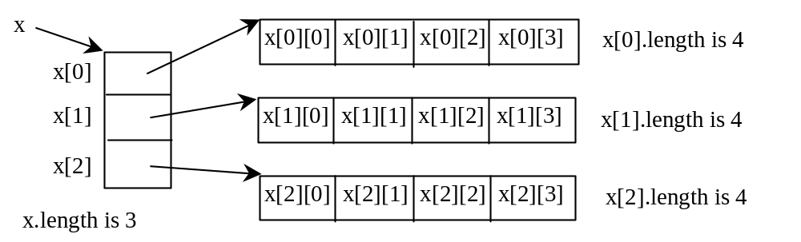
Lengths of Two-dimensional Arrays
int[][] x = new int[3][4];

Slide 77
Lengths of Two-dimensional Arrays, cont.
int[][] array = {
{1, 2, 3},
{4, 5, 6},
{7, 8, 9},
{10, 11, 12}
};
array.length
array[0].length
array[1].length
array[2].length
array[3].length
array[4].length ArrayIndexOutOfBoundsException

Slide 78
Ragged Arrays
Each row in a two-dimensional array is itself an array. So, the rows can have different lengths. Such an array is known as a ragged array. For example,
int[][] matrix = {
{1, 2, 3, 4, 5},
{2, 3, 4, 5},
{3, 4, 5},
{4, 5},
{5}
};
matrix.length is 5
matrix[0].length is 5
matrix[1].length is 4
matrix[2].length is 3
matrix[3].length is 2
matrix[4].length is 1

Slide 79
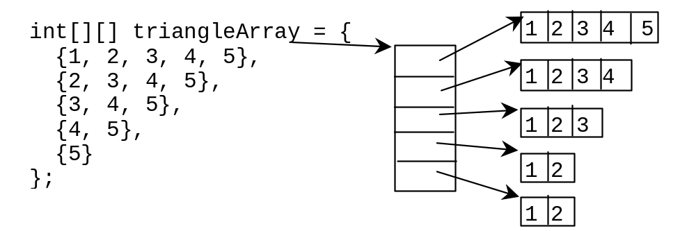
Ragged Arrays, cont.

Slide 80
Multidimensional Arrays
Occasionally, you will need to represent n-dimensional data structures. In Java, you can create n-dimensional arrays for any integer n.
The way to declare two-dimensional array variables and create two-dimensional arrays can be generalized to declare n-dimensional array variables and create n-dimensional arrays for n >= 3. For example, the following syntax declares a three-dimensional array variable scores, creates an array, and assigns its reference to scores.
  double[][][] scores = new double[10][5][2];

Slide 81
Review of Learning Objectives
You should now be able to
Explain why arrays are necessary in programming.
Describe the steps involved in using arrays: declaring array reference variables and creating arrays.
Initialize the values in an array.
Access array elements using indexed variables.
Declare, create, and initialize an array using an array initializer.
Copy contents from one array to another.
Develop and invoke methods with array arguments and return value.
Declare a method with variable-length argument list (§6.6).
Use the methods in the Arrays class (§6.9).
To declare and create two-dimensional and multidimensional arrays to solve programming problems.

Slide 82
To Do
Review the slides and source code for this chapter.
Read up the relevant portions of the recommended text (see next slide).

Slide 83
Reference
Main text:
Chapter 6, pp. -
Extracted from slides by Liang, Introduction to Java Programming, 7th Edition © 2009, Prentice Hall

